Slide 1

A Study of Consumer Behavior on the Rise of OTT Platforms
Presented by,
Asma Shaikh - 908
Shubham Upadhyay - 915

Slide 2
Introduction
The aim of this research project is to conduct a comprehensive market research and analytics study focusing on the rise of OTT platforms and analyzing consumer behavior in relation to television and OTT usage.
Through this study, we aim to gain insights into various aspects of OTT platforms, including user preferences, spending patterns, content preferences, and the impact of the COVID-19 pandemic on consumer behavior.
By understanding these factors, we can shed light on the changing landscape of television viewing and the increasing prominence of OTT platforms in India.

Slide 3
Data Introduction
This survey was circulated to various regions of Mumbai
Primary Data
data has been collected through a questionnaire with responses from 202 respondents from Students, working professionals, Unemployed people, Retired people & Housewives from every- age group
The data was collected between the time period of 14th February 2023 to 15th April 2023
Secondary Data
Secondary data were taken from Kaggle which has around 527 Responses
The data was updated on May 22nd , 2021

Slide 4
Objectives
1. To Study the concept of OTT Platforms.
2. To know which age group is more likely to use OTT Platforms.
3. To Know which OTT Platform is most preferred by Indians.
4. To compare the usage of OTT Platforms with TV.
5. To Know the average monthly spending of Indians on OTT Platforms.
6. To Know the average time spent by Indians on OTT Platforms.
7. To Know what Indians, prefer mostly to watch on OTT Platforms.
8. To Know if Covid-19 increased the demand for OTT Platforms.
9. To Know the satisfaction level of Indians from OTT Platforms.

Slide 5
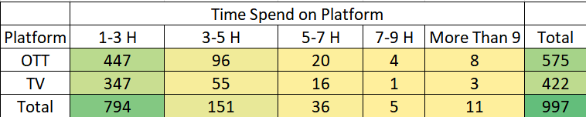
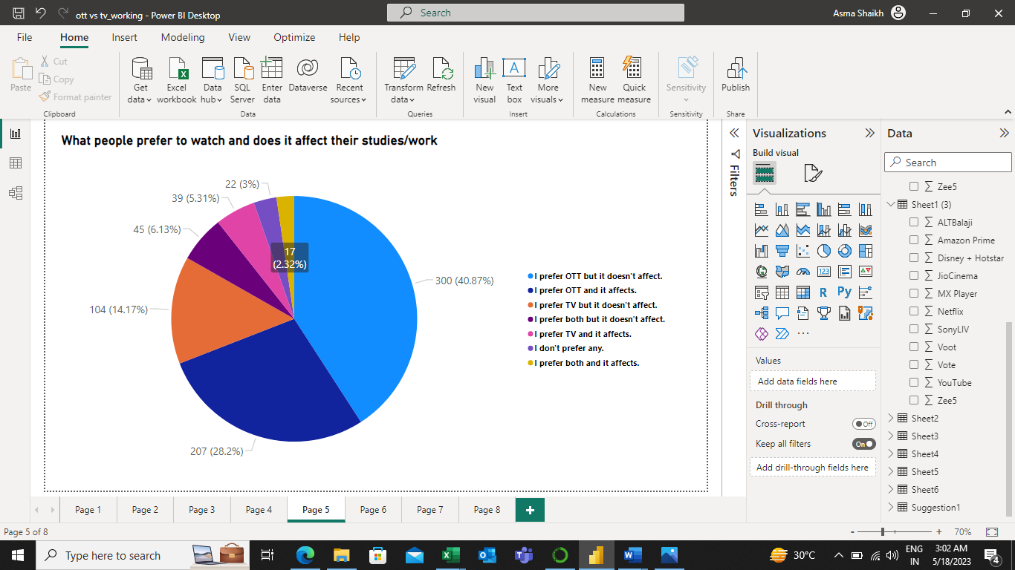
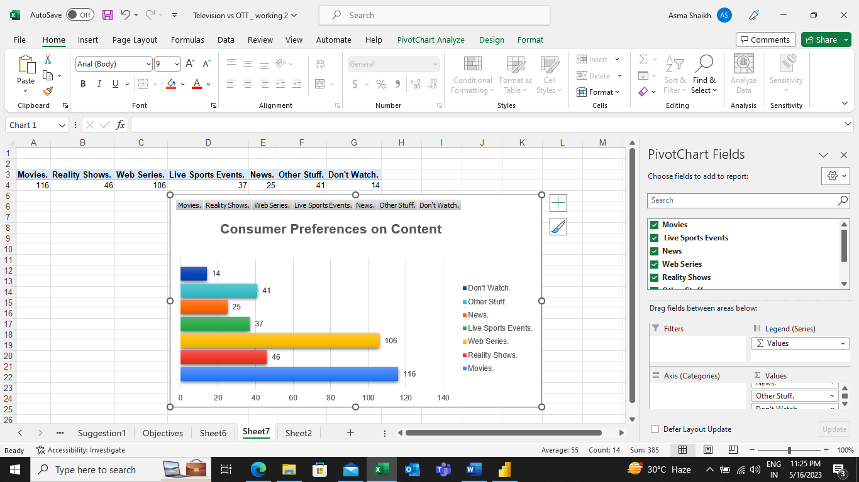
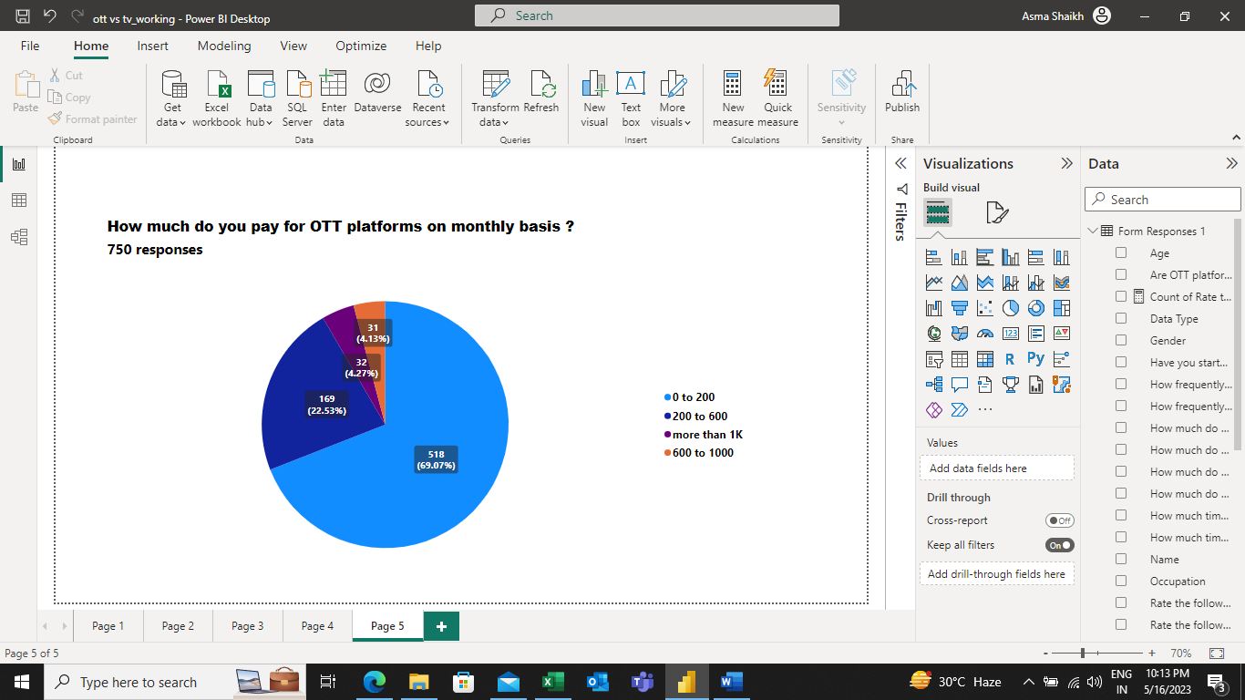
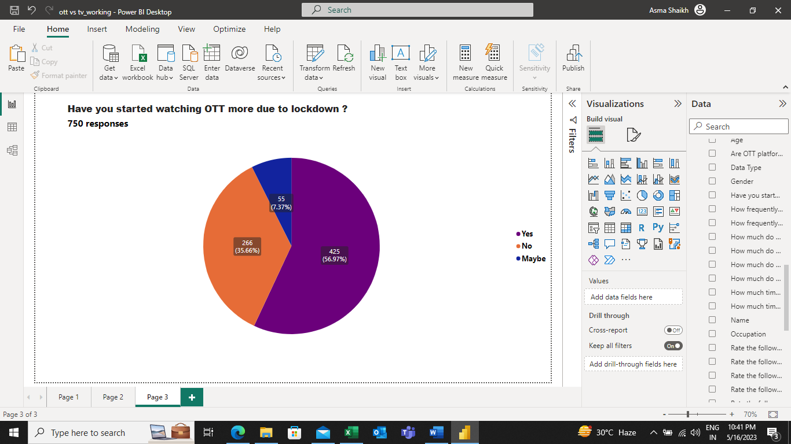
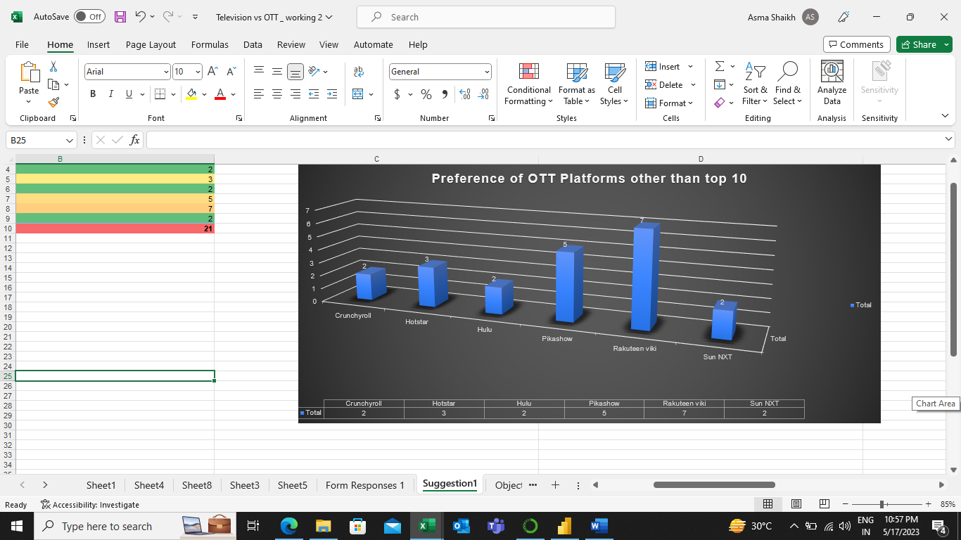
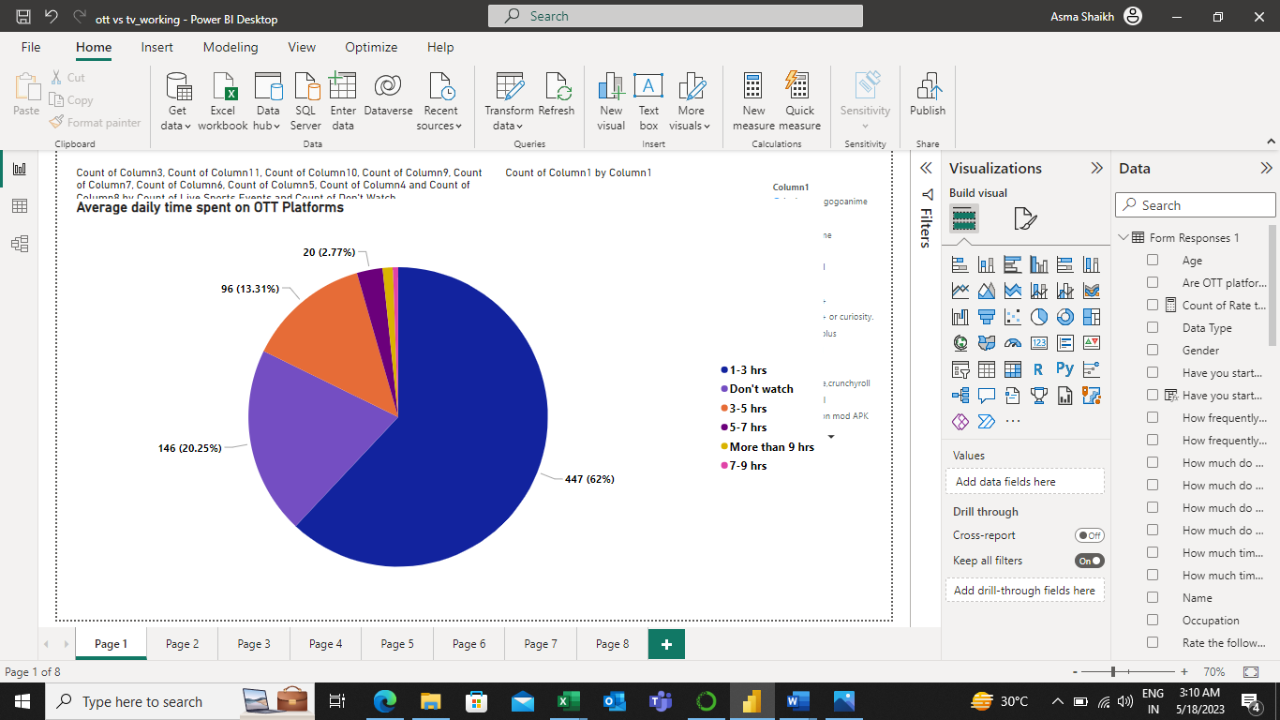
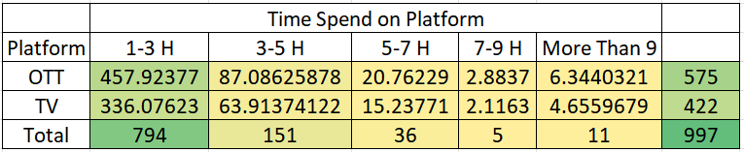
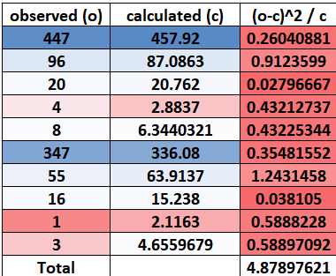
Satisfaction level of Indians from OTT Platforms
Comparing the usage of OTT Platforms with TV
preference of other OTT Platforms than the top 10 mentioned in our study
preference of other OTT Platforms than the top 10 mentioned in our study
Which OTT Platform is most preferred by Indians
To Know if Covid-19 increased the demand for OTT Platforms
Consumer Preferences on Content
To know which age group is more likely to use OTT Platforms
Average time spent by Indians on OTT Platforms
10
Average monthly spending of Indians on OTT Platforms
H0: There is no relationship between TV/OTT preference and the audience's watching time
vs
H1: There is a relationship between TV/OTT preference and the audience's watching time
9
The below Fig reveals that 69.07% of respondents out of the total have voted for preference on OTT Platforms over TV and claim that consumption of OTT Platforms doesn’t affect their studies/work.
This reveals that Indians are very satisfied with the use of OTT Platforms.
On an average 62% of Consumers are spending 1-3 hours on OTT Platforms daily and the remaining spend less or more than that.
8
From our Study:
56.97% of consumers feel that the lockdown has led to an increase in the consumption pattern of OTT.
Through the Figure beside we can observe that on an average 69.07% of consumers out of the total are spending 0-200 rupees (Basic Monthly Plan), and the remaining are spending more than that
Rakuten Viki is most preferred followed by Pikashow, Hotstar, Sun NXT, etc.
7
Based on the chi-square statistical analysis, the calculated chi-square value of 4.87 is less than or equal to the tabular chi-square value of 9.48. As a result, we accept the null hypothesis (H0), indicating that there is no significant relationship between TV/OTT preference and the audience's watching time.
6
5
4
Research Paper Reference:
(ijaem.net)
COVID-19 increased the average consumption of OTT among 66.2% of users with 1-3 hours per day.
3
Movies and Web Series are highly preferred Content to watch on OTT Platforms followed by Reality Shows, Live Sports Events, etc.
YouTube has got a maximum rating as the highest preferred OTT Platform followed by Netflix, Amazon Prime, Disney + Hotstar, etc. Other than that, Jio Cinema and Zee5 have got a maximum second-highest rating.
Consumers belonging to the 11-20 and 21-30 age categories are more in touch with OTT Platforms and hence those are key consumers of OTT
2

Slide 6
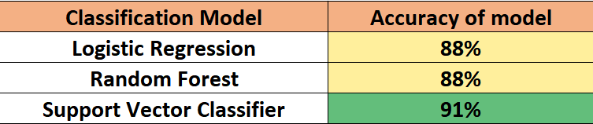
Machine Learning Analysis
Step 1: Load Data Set Step => Step 2: Label Encoding => Step 3: Split X & Y => Step 4: Apply Feature Engineering => Step 5: Train & Test => Step 6: Apply Different Classification Model
Final Result
The accuracy scores achieved by these models were found to be quite similar, indicating that they performed comparably in terms of predictive accuracy. However, the Support Vector Classifier (SVC) stood out among the different models with the highest accuracy score of 91%. This outcome suggests that the SVC model is particularly well-suited for our dataset and provides a strong fit for our classification task.

Slide 7
Key Findings
1. 100% of respondents are aware of OTT Platforms.
2. Majority of the respondents using OTT Platforms are from the age of 11-30.
3. Netflix with 41% and Amazon Prime with 26% are Dominant OTT Platforms followed by Disney+ Hotstar with 17.2%.
4. Entertainment, Mobility, Content on demand, Unique content, Cost Effectiveness, language, and ease of use are some of the primary reasons for preferring OTT over TV by consumers.
5. On average consumers are spending 0-200 rupees on OTT monthly subscriptions followed by 69.07% of the total and the remaining are spending more than that.
6. On average consumers are spending 1-3 hours on OTT followed by 62% of the total and the remaining spend less or more than that.
7. Consumers are preferring web series at 75.6% followed by movies at 59.2%, reality shows at 26.9%, etc., to watch entertainment content on OTT.
8. COVID-19 increased the average consumption of OTT among users by 1-3 hours per day followed by 66.2% out of the total.

Slide 8

Thank You

